Slide 1



Centrient Internal Boot Camp - Infra
18 Nov 2022

Slide 2

Agenda
Leadership Team – Centrient & TechM
Centrient – Infra Team
Transition – Org Structure
Scope
Centrient Environment
Platform and Infrastructure – Observations/Inferences
Transition Timelines
Transition Methodology
Expectation from Client and Incumbent
Transition Governance
Incidents Flow
Transition Risks & Mitigations
Transition Guidelines

Slide 3

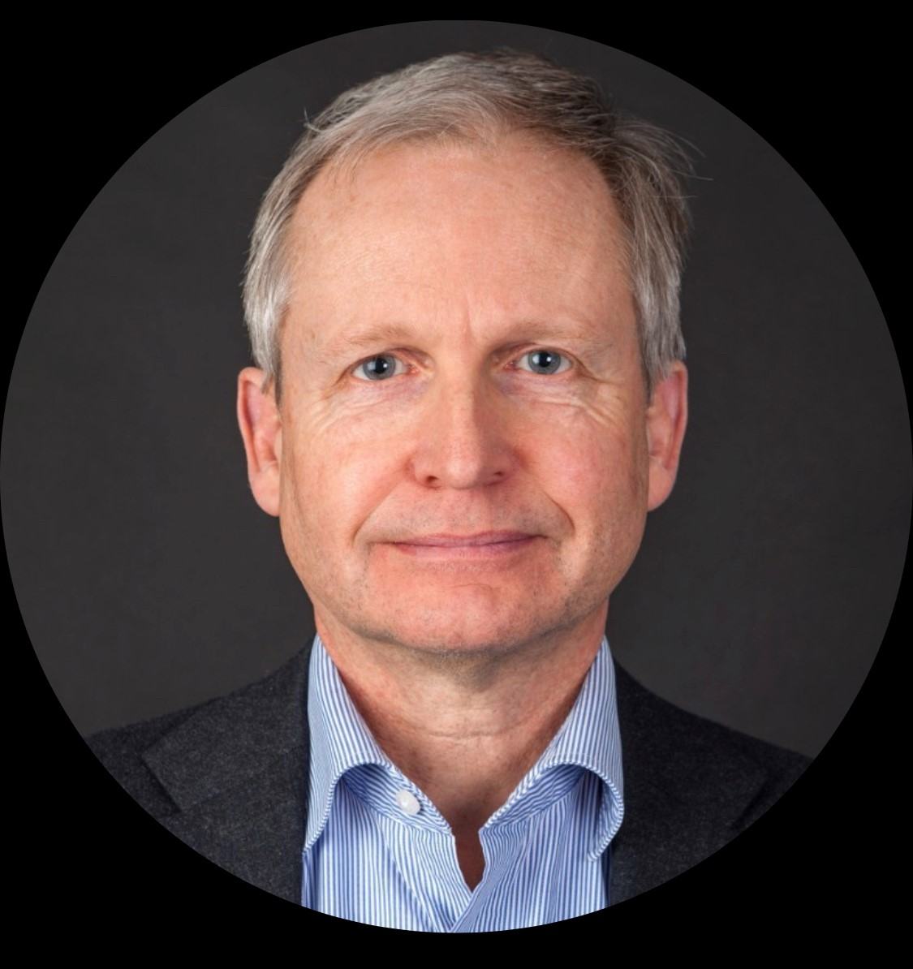
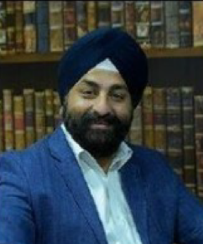
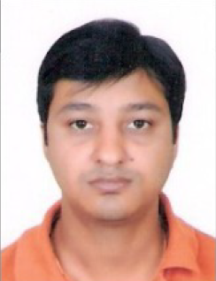
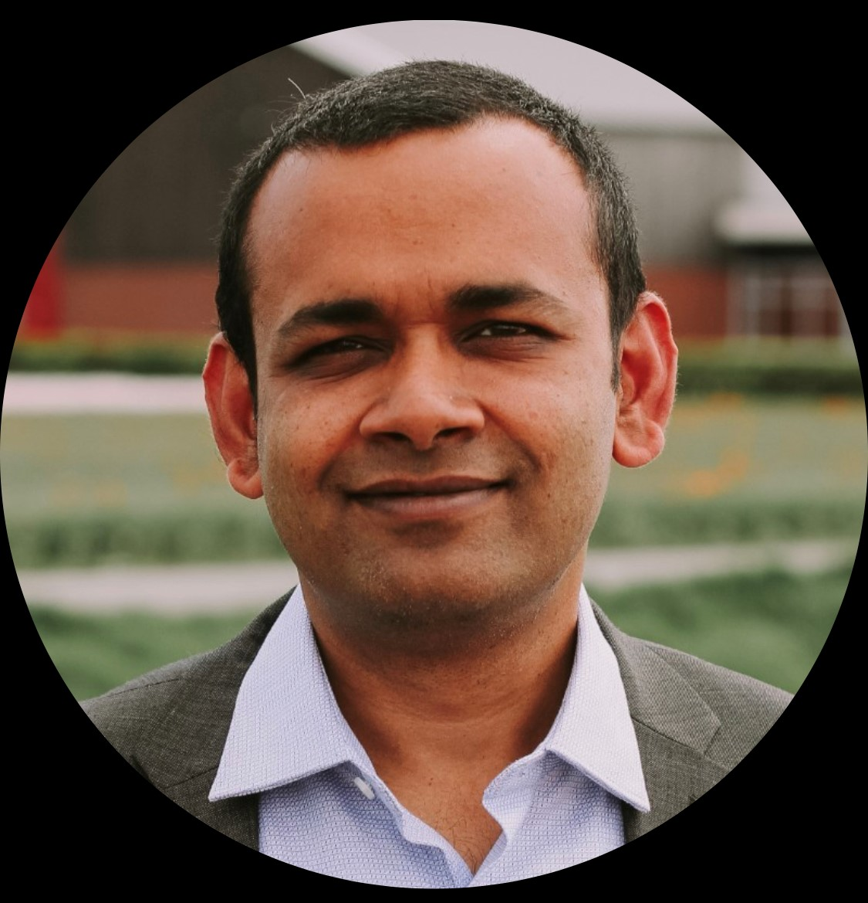
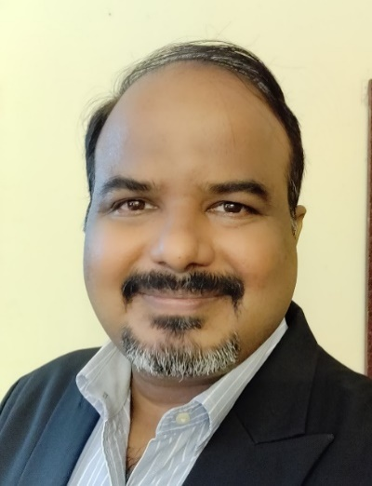
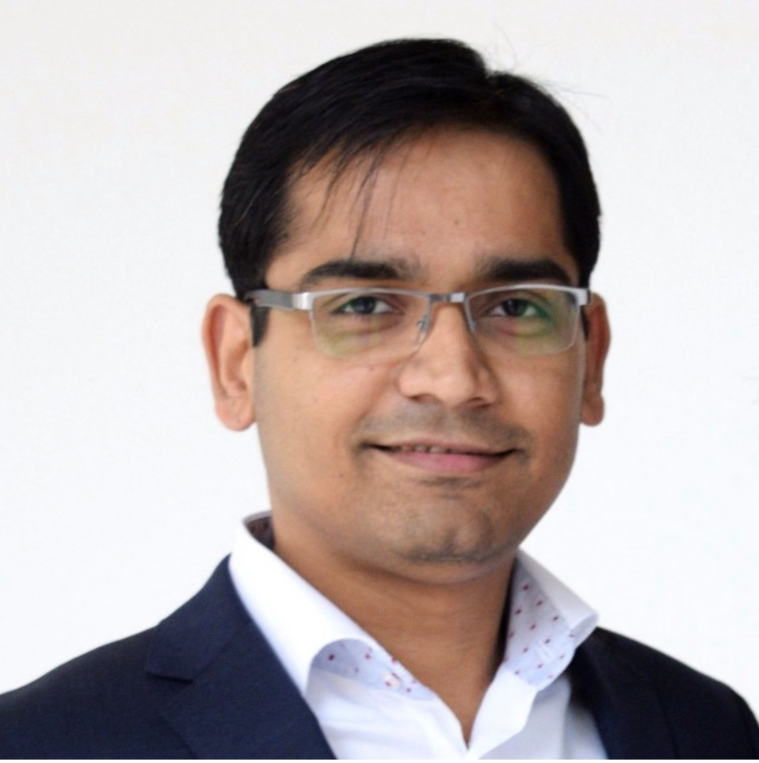
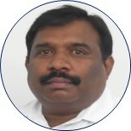
Leadership Team – Centrient & TechM
Ronald Merckx
Chief Financial Officer
Marnix Hoop
CIO – Centrient
Amandeep Bawa
Head IT- Infrastructure
Amit Sahu
Head SAP COE & Architect
Sandeep Agarwal
VP Country Head
Srikanth Uppuluri
VP Global Delivery - ILS
Amar Gupta
AVP Sales
Varaprasad Inturi
India Business Head - Healthcare & Life Sciences

Slide 4
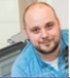
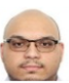
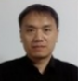

Centrient – Infra Team
Amandeep Bawa
Head IT- Infrastructure
amandeep.bawa@centrient.com
Rowald Laterveer –
IT operation Manager NL
rowald.laterveer@centrient.com
Technical Tower Handled
Azure
Security management
EUS ( Onsite)
Pranav Sethi –
IT operation Manager Global
pranav.sethi@centrient.com
Technical Tower Handled
Azure
Compute OnPrem
Security management
EUS
Qing Xie –
IT Manager China
qing.xie@centrient.com
Technical Tower Handled
Network
Singh, Maninder –
IT Manager India
maninder.singh@centrient.com
Technical Tower Handled
Network

Slide 5







Transition – Org Structure
CENTRIENT
TechM Account Mgmt.
TechM Transition Mgmt.
TechM Transition Teams
Srikanth Uppuluri
Global Delivery Head (ILS)
SAP App Support Teams
CSV Compliance Support
Marnix De Hoop
Saurabh Srivastava
SAP Transition Mgr.
Sandeep Agarwal
Regional Sales Head
Saurabh Nandavar
Infra Transition Mgr.
Santosh Goswami
Service Delivery Mgr.
Azure –
Viswanathan Gopalakrishnan
EUS (MDM,Patch Mgnt,AD,S/W,Pack&Dist)
Kiran Mugada
Amit Sahu
SAP
Amar Gupta
Accunt Head
Compute On-Prem -
Kiran Mugada
Network
Dharmendra Kumar
Tarun Verma
SMO
Amandeep
Infra Head
EUS – Onsite
TBI
Security Services –
Turlapati Venkatachala Bharadwaj
Varaprasad Inturi
Delivery Head
SAP Solutions Support : Vishwas / Meenakshi Infra Solutions Support : Prabhu / Ananth

Slide 6


Scope
Application Services
Network services
Platform & Infra Services
Workplace services
Security services
Onsite Services
Service management and ITSM tooling
ServiceDesk Services
Service Desk Support
TechM ITSM to be Integrated with Centrient ITSM
Halo ITSM
H&F Support for HQ Location
H&F Support for other location
End Point Security
Certificate Mgmt
Server AV Update
HSM
Security Control
Patch Management
Print Management
Application Packaging
MDM
Devices, End user Support
Engineering Services
SAP Management
Non-SAP Management
LAN Management
WLAN Management
Devices, WAN, Smart hand Support
Managed Services
Cloud Subscription
DC Hardware, License

Slide 7













Understanding of Centrient Environment
SERVER ESTATE
NETWORK ESTATE
11
97
80
21
Physical Server
Aruba Switches
Access Point
Virtual Server
Azure Cloud
Aruba Console
60
Windows -39
Unix - 21
END USER SERVICES & SECURITY
SERVICE MANAGEMENT & ITSM
2137
AD Accounts
2000+
ATOS TICKETS
MDM
~ 1002
~ 851
05
PACKAGED APPLICATIONS
PER MONTH
AVG Incident PM
AVG Incident PM
~ 56
McAfee AV
INTUNE
SCCM
END POINT SECURITY
PKI
HSM
HAM & SAM
AVG Change PM
~ 685
AVG Events PM

Slide 8
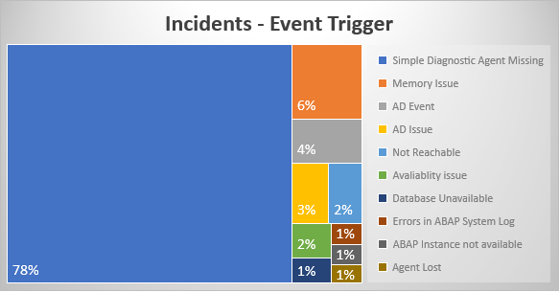
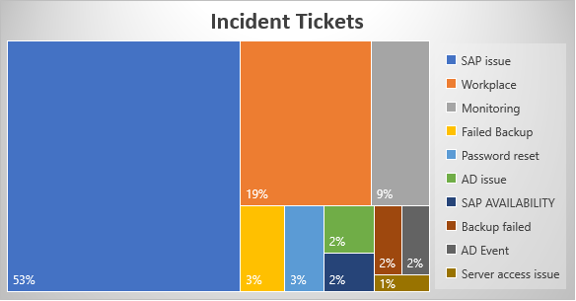
Platform and Infrastructure – Observations/Inferences
* Based on ticket analysis of ATOS dump provided
Ticket Analysis
~ 60 Incidents /month & 1412 event related Incidents /month
P3 ,P4 & P5 tickets contributes to 89% of overall incidents volumes
Top 5 Module contributors- SAP Issue, Workplace, AD, Failed Backup, Password reset
Observations
Missing Event Correlation & Enrichment
Low automation
Solution Tenets
Proactive monitoring, Event Correlation & Enrichment using MF OpsBridge
Enablement of Automation – Out of Box Automation & Custom build bots, available with iCOPS
Cost Optimization recommendation and implementation
Integrated Operations for Cloud & On-Prem

Slide 9
Transition Timelines
24/10
31/10
7/11
14/11
21/11
28/11
5/12
12/12
19/12
26/12
2/01
09/01
16/01
23/01
30/01
06/02
13/02
20/02
27/02
Y1 – Y3
Program Mgmt. Setup
Program Management
Communication, Risk Management, Management of Change , Governance & Reporting
Transition Enablers:
Pre-defined questionnaires; Knowledge capturing templates;
Gating checklists; Recording & playbacks;
Stabilization
3 months
Establish Network connectivity - VPN
Core Team Resource Ramp Up
Stabilization of 3 months post Go Live- Activities
Detailed Transition Plan
Deploy EPSELON Tool
SMAX Implementation
Finalize KPI and baseline SLAs
Visual Dashboards enabling standardization
SLA benchmarking and implementation
TechM Cloud SMAX ITSM Deployment - MVP
ITSM Integration
B2B ITSM Integration
Dry Run
iCOPS tooling
AI Ops & Event Management Integration
Dry Run
ITSM KT
KA
SS
PS
SAP Apps - High
Knowledge Acquisition ( KA)
Shadow Support(SS)
Primary Support( PS)
SAP Apps - Medium
Knowledge Acquisition ( KA)
Shadow support
Primary Support( PS)
Steady State
SAP Apps - Low
Knowledge Acquisition ( KA)
Shadow support
Primary Support( PS)
SAP Apps - Other
Knowledge Acquisition ( KA)
Shadow Support(SS)
Primary Support( PS)
Azure Cloud
Knowledge Acquisition ( KA)
SS
PS
DC Servers
KA
SS
PS
Network Services
KA
SS
PS
End User Services
KA
SS
PS
End User Services Onsite (NL & ES)
KA
SS
PS
Security Services
KA
SS
PS
CSV Services
KA
SS
PS
Kick Off
Transition Plan Sign Off
SOW & MSA Sign Off
B2B Integration Sign Off
App Go Live
MOU Sign Off
Transition Dashboard
Infra Go Live

Slide 10
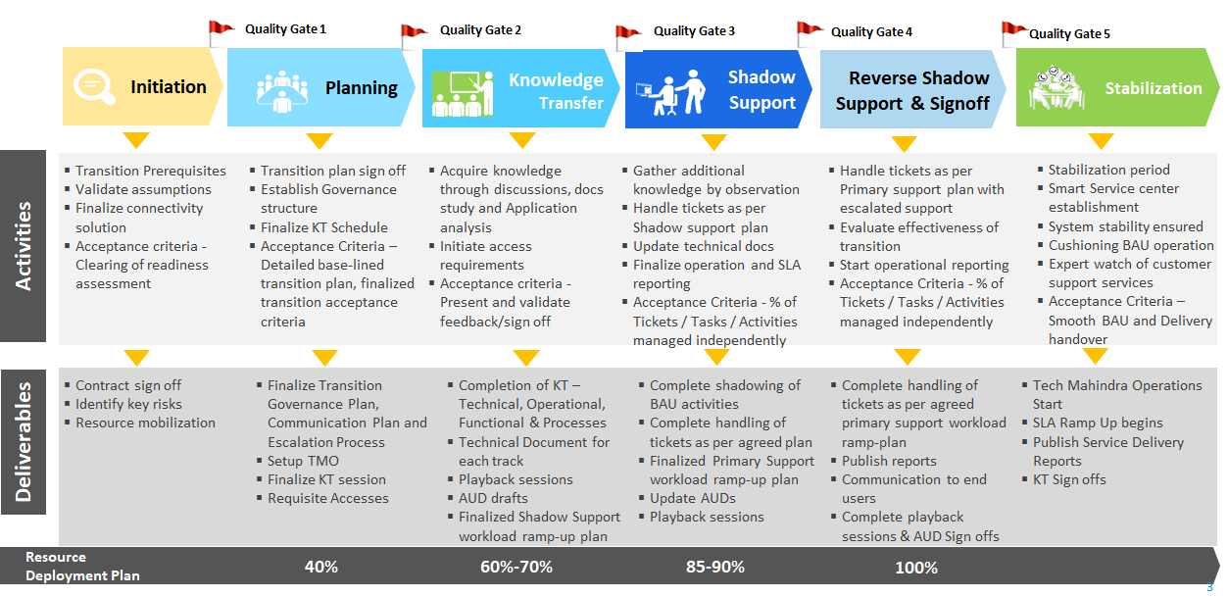
Transition Methodology

Slide 11
Expectation from Centrient and Incumbent (ATOS) – Discussed with Client
Centrient
Participate in Transition Kick-off
Identify SME’s and provide availability calendar
Provide Functional & Technical KT
Involve TechM in Ticket resolution, Closing activities
Provide guidance for resolution as needed
Participate in Transition Kick-off; Reiew and agree on KAP Plan
Provide Functional (if applicable) & Technical KT
Playback Review and Sign-off Deliverables
Collect information
Atos
Role | Details | Transition Planning | Transition Execution
 |  |  | Knowledge Transfer | Secondary Support | Primary Support
Steering Committee Biweekly Meetings | Amit, Amandeep, Vara, Sandeep, Marnix, Srikanth | 2-4 hours per week | 2-4 hours per week | 2-4 hours per week | 2-4 hours per week
Transition manager(s)- Weekly Meetings | Amit, Amandeep, Saurabh S, Saurabh N, Atos- Frans & Paul | 10 hours per week | 10 hours per week | 20 hours per week | 40 hours per week
Atos SME’s- Daily Mtgs | TBD | 10 hours per week | 20 hours per week | 15 hours per week | 10 hours per week
Centrient SME’s- Daily Mtgs | Relevant Centrient SMEs for different tracks | 5 hours per week | 10 hours per week | 10 hours per week | 10 hours per week
Centrient Lead’s weekly Mtgs | Roberto, Leo, Nathalie, Roland, Pilar, Amandeep, Amit | 2 hours per week | 2 hours per week | 2 hours per week | 2 hours per week

Slide 12
Transition Governance
Discussion
Frequency
Key Attendees
Discussion points
Centrient CIO
Centrient SAP & Infra Heads.
Centrient Legal & Procurement
TechM Delivery & Sales Head
TechM TM & SDM
TechM Account & Delivery Mgmt.
Vendor TM
Weekly Status report - consolidated for all Tracks
Decision on Risk & Issues impacting timelines or commercials
Milestones & Quality gates achievement status
Resource deployment Plan
Steering Committee Discussion
Biweekly
Program / Transition Mgmt. Review
Weekly
TechM SDM
TechM Transition Manager
TechM Account & Delivery Mgmt.
Centrient SAP & Infra Heads.
Vendor TM
Weekly Status report - consolidated for all Tracks
Risk & Issues discussion
Transition phase deliverables status
Milestones & Quality gates check
Operational Connects
Daily
SDM
SAP Module Leads
Infra Module Leads
Transition Managers
KT Progress Updates
Risk & Issues
Alignment on transition phase and deliverables status
Documentation updates

Slide 13












Incidents Flow
Legend
Centrient Existing Tool
TechM Proposed
Service Management
Account Management, Governance & PMO
Network
Server
Azure Cloud
Centrient Infrastructure
Patching
Events
Events
Events
Orchestration
Server Discovery & Patching
Azure Monitor
LAN Management
Azure App Analytics
Server Monitoring
Automation Layer
Events
Events
Events
Patching Device’s
LT & DT’s
AIOPs & Event Management
Service Mapping
Event Co-relation/Single Event Screen
Proactive
ITSM B2B Integration
Reactive
TechM
ITSM
Incident Management
Problem Management
Change & Release Management
Service Level Management
Service Catalogue and SRM
Knowledge Management
Asset Management
Service Catalogue Mgmt
Centrient User
TechM Support group
L1.5 Support
L2/L3 Support
Centrient Support Group

Slide 14
Transition Risks & Mitigations
Risk / Issue | Mitigation | Risk Category | Responsibility | Probability | Impact
Lack of Commitment from Incumbent SME's | Leads to be involved in discussions and Sign Off the KT tracker contents . Centrient Leads to bridge Gaps in KT topics. | People | Incumbent | Medium | Medium
Delay in establishing dedicated network connectivity might delay the overall Transition due dependency with shipment of Cato VPN Socket / Customs Clearance. | Centrient to facilitate 20 ID's for SSL VPN connection - to kick off the KT activities. | Connectivity | TechM/ Centrient | High | Medium
Transition schedule coinciding with Holiday period (Christmas and New Year) - can impact completion of KT during the stipulated transition duration | Holiday Calendar to be updated in advance and additional sessions to be planned wherever limited availability of Atos SME's Centrient SME's to bridge KT GAPS during unavailability of Atos SME's | People | Incumbent/Centrient | Low | Low
Unavailability or incomplete documentation shared during Transition – will impact knowledge acquisition | Knowledge portal access for Centrient document repository to be provided to TechM during KT for Document Validation .Incumbent Vendor to update & handover all documentation during the transition period. | Documentation | Incumbent | Medium | High
Ramp down of SME's during transition period | Centrient Leadership should list out Key SME's and have an agreement from Atos for retaining these SME's till Go Live | People | Incumbent | High | Medium
Open Incidents and CR’s before Service take over | TechM Proposes that Atos handles all open incidents during transition and after transition cut over, pending incidents/CR’s will be taken over by TechM team with proper KT of those incidents/s. Long Pending Incidents & CRs more than 30 days has to be closed by Atos. | Process | Incumbent | Low | Low
In-Flight projects. (Scope Understanding and KT for those In-flight projects after agreeing on takeover) | Criteria will be defined along with Centrient Leads for taking over In-Flight projects and based on the defined criteria, TechM will consider taking over In-Flights projects after proper KT from Atos or any 3rd party Vendors. For In-Flight Projects take over, TechM considers a Change request to be raised and identify resources to execute the same. | Process | Centrient | Low | Low

Slide 15
Guidelines
Centrient Business Hours - 12.30 PM to 09.30 PM - IST
Associate Etiquettes:
Communication :
All the verbal communication should be only in English.
No slang at any point of time
While communicating to client executives, be formal and courteous.
Meeting
Be punctual
Please be prepared for meetings by jotting down the key points to be discussed.
Pay attention to everyone in the meeting to avoid same topics being discussed over and over again.
Listen first.
Keep cell phones on silent mode.
Minutes of meeting is mandatory.
Turn ON the video
Email
Keep e-mails concise and precise
Read entire trail mail before raising queries as the trail mail might answer your query
Use Discretion for BCC, CC, and ‘Reply all’
Forwards are strictly for business purpose only.
Allow enough time to respond before following up.
Set “Out of Office” with proper contact details.

Slide 16


Slide 17

Thank you

